Slide 1
Organizational Strategy for AccelRR8 Consortium NonProfit
Rich Reba, President
August 6, 2026

Slide 2
AccelRR8 Consortium Strategy
Realizing Our Long Term Ambition
Staying Focused On Our Opportunity
Doing What It Takes To Succeed
Executing Our 3-Horizon Strategy

Slide 3
Consortium Intent
Our Big Question | Humanity is underserved by the Tech Services industry because few providers are growing value exponentially The Tech Services industry generates $1T+ revenue annually and serves all major industries A few hyper-scalers, who grow value exponentially, are disrupting masses of traditional providers Our founders have influenced change and grown value exponentially in the Tech Services Industry Tech Services leaders in the US and other countries also want to grow value exponentially How can we scale our experience, knowledge, and influence to help the Tech Services industry, and thus humanity (including ourselves and our families), as much as we can?
Our Big Idea | We intend to help the Tech Services industry help humanity by continuously: Cultivating a network of enterprising Tech Services leaders who want to grow value exponentially Curating a living Body of Knowledge that captures our collective learnings about how to do this Innovating across the network to advance the state of the art in growing value exponentially We will create, operate, and scale a 501(c)3 non-profit organization to carry out our intent

Slide 4
Consortium Ambition
Who we are
Technology Services Industry Consortium
Founded in December 2023
Non-Profit Organization registered in Maryland
Rich Reba, President, is a former Fortune 200 C-suite Executive and Tech Consulting GM with current certifications (AI, Agile, CPO, etc.)
Licensed to use Rich Reba’s personal AccelRR8 brand, owned by AccelRR8 LLC
AccelRR8 LLC, a for-profit company, is not an affiliate. It is a patron whose employees and associates are participants in the consortium
Asset-light with very low overhead costs
What we want
Mission is to help enterprising Tech Services industry leaders harness proven accelerators to grow value exponentially at scale
Purpose is helping Tech Services industry leaders work together to accelerate success for themselves, their industry, and all humanity
Vision is Tech Services industry leaders everywhere enjoying exponential success in their industry while helping humanity live increasingly better lives
Ambition is to be the consortium that Tech Services industry leaders credit with generating exponential improvements in industry effectiveness and impact

Slide 5

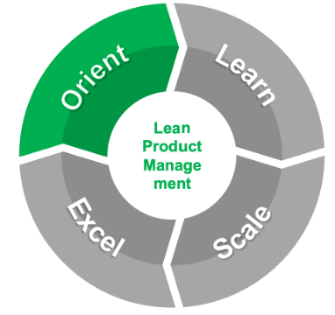
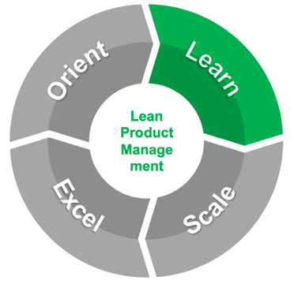
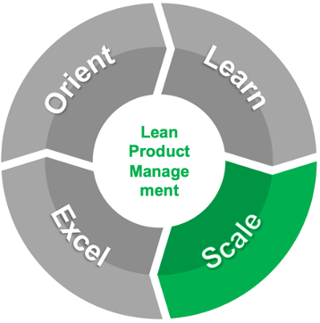
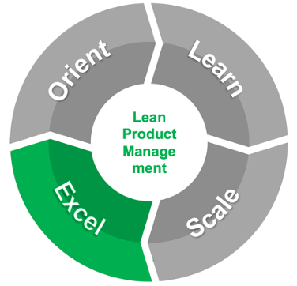
Realizing Our Ambition Exponential improvements in Tech Services that help humanity
Start Small with Early Adopters
Scale Rapidly Across the Chasm
Go Big
with Mainstream Adoption
2020s
We are executing our 3-Horizon Strategy
We are Orienting and Learning about the Services needed
2030s
We will hit an inflection point after which growth will be self-sustaining
We will Scale our Learnings across our Services Portfolio
2040s+
We will materially improve Tech Services and help humanity
We will Excel at providing sophisticated Services at scale

Slide 6
AccelRR8 Consortium Strategy
Realizing Our Long Term Ambition
Staying Focused On Our Opportunity
Doing What It Takes To Succeed
Executing Our 3-Horizon Strategy

Slide 7
Staying Focused On Our Opportunity
Is it Real? | How big is the market? | The Tech Services industry generates $1T+ annual revenue and serves all major industries globally
 | Is there a real customer problem to be solved? | Hyper-scalers who harness exponential accelerators are disrupting traditional Tech Services providers
 | Is there a real need out there? | To survive and thrive, traditional Tech Services providers must also learn to harness exponential accelerators
 | Is there a dissatisfactory state-of-affairs? | Tech Services leaders lack the resources to help traditional providers harness proven accelerators to grow exponential value at scale quickly – THUS the Tech Services industry isn’t benefiting humanity at its potential
Can we Win? | Capabilities and competencies | Consortium leaders have experience helping providers grow value exponentially at scale
 | Assets, IP, and tech breakthroughs | The AccelRR8 Framework and associated AccelRR8 Body of Knowledge helps enterprising leaders harness proven accelerators to grow value exponentially at scale quickly
 | Resources and relationships | Consortium leaders have relationships with many influencers who created and/or led organizations that have had a material impact on technology and other industries worldwide
 | What sets the org apart from competitors? | Rather than trying to boil the ocean, the Consortium is focused on helping Tech Services leaders harness 5 proven accelerators which are mathematically capable of growing value exponentially at scale
Is it Worth it? | Do the unit economics work? | As a non-profit, the goal isn’t income generation for the Consortium itself. Since the Consortium intends to remain asset-light, income is needed to cover the cost of collaboration platforms, innovation, and marketing
 | Can the org make money? | The Consortium can accept charitable donations but cannot share profits (dividends or owner’s draws). Donations will increase as Tech Services leaders use Consortium services to grow value exponentially at scale.
 | What is the revenue model? | The Consortium will offer paid subscriptions and solicit grants from patrons to enhance the AccelRR8 Body of Knowledge, and collect fees in exchange for future premium non-profit services
 | How is the org going to monetize? | As Tech Services leaders make use of the Consortium’s services, they will begin growing value exponentially at scale, which will generate exponential demand for Consortium services in a virtuous cycle
 | What is the financial math behind the product opportunity? | The Consortium will make and spend very little money unless and until a critical mass of Tech Services leaders urgently believe they need to learn how to harness exponential accelerators – then financials will hockey stick

Slide 8
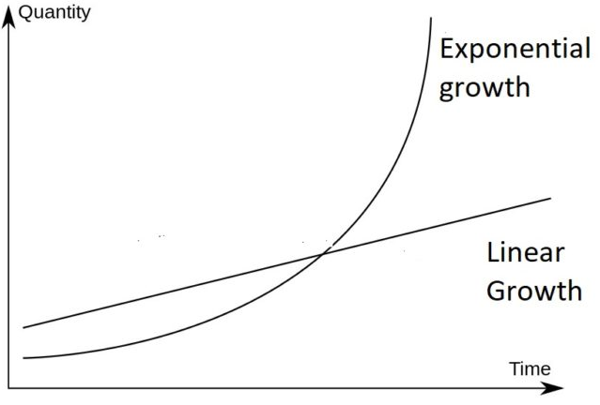
Growing Value Exponentially
CORE PREMISE
Harnessing 5 proven accelerators makes it mathematically feasible to grow value exponentially
The AccelRR8 Framework
Growing value exponentially at scale is complex
There are only a few mathematically feasible ways to grow value exponentially
Harnessing these proven “value accelerators” at scale has key challenges
Each challenge can be overcome with proven solutions
A framework can help leaders grasp and harness these complex concepts
It simplifies and gives structure to a set of proven methods used to grow value exponentially
We’ve branded this the AccelRR8 Framework
The AccelRR8 Framework is at the heart of the AccelRR8 Body of Knowledge
Value
Exponential
growth
https://blog.ucsusa.org/doug-boucher/world-population-growth-exponential/

Slide 9
AccelRR8 Consortium Strategy
Realizing Our Long Term Ambition
Staying Focused On Our Opportunity
Doing What It Takes To Succeed
Executing Our 3-Horizon Strategy

Slide 10
Consortium Doing What It Takes To Succeed
Desirable | Enterprising leaders want to grow value exponentially, but few know how to do it Stakeholders appreciate and want to associate with our values and culture
Viable | The Consortium is goal-oriented and focused (not trying to boil the ocean) We have the required leadership and know-how to spark exponential growth and impact We will learn from other successful non-profit organizations who offer similar services Minimal investment is needed to achieve initial success (asset-light with low overhead costs), which gives us time and flexibility to experiment, learn, and adjust
Sustainable | Our core premise – harnessing 5 proven accelerators makes it mathematically feasible to grow value exponentially – is enduring We will still be relevant in decades even as AI, Quantum Computing, etc. advance exponentially
Impactful | The Consortium will harness proven accelerators to grow our own value exponentially Our own success will be a key proof point of our core premise As we gain credibility, we will create a virtuous cycle of exponential growth and impact
Consumable | Becoming and remaining a subscriber, patron, and/or consortium leader must be easy The net value delivered by fee-based services / features must be self-evident

Slide 11





Consortium Peers
Similar Non-Profits | How We’re Similar |  | Our Intent
 | We bring together stakeholders to connect and empower humanity |  | Mentor a critical mass of Tech Services leaders on leading a movement that grows value exponentially
 | We help leaders network and develop important skills that can help them advance in their career |  | Help Tech Services leaders network and practice growing value exponentially at scale together
 | We curate a Body of Knowledge proven helpful in doing complex work most leaders must do |  | Help Tech Services leaders align on authoritative practices for growing value exponentially at scale
 | We help people and organizations get the most value out of their investments |  | Help Tech Services leaders learn generatively how to solving vexing enterprise challenges
 | We help leaders use Artificial Intelligence technologies and know-how to help humanity |  | Help Tech Services leaders use AI ethically and responsibly to help their industry and humanity
Notes:
Such as what?

Slide 12
AccelRR8 Consortium Strategy
Realizing Our Long Term Ambition
Staying Focused On Our Opportunity
Doing What It Takes To Succeed
Executing Our 3-Horizon Strategy

Slide 13
Consortium 3-Horizon Impact Strategy Exponential Improvements in the Tech Services Industry
These exponential improvements in Tech Services industry production inputs will yield exponentially better industry outputs and outcomes. This will become more self-evident as each exponential solution is proven and then scaled virally across the industry.
Pack a Snowball HORIZON 1
Roll it Downhill HORIZON 2
Trigger an Avalanche
HORIZON 3
Services
Professional Networking
Network Effects: 1,000 Subscribers
Viral Ideation: 10 Viral Ideas
Generative Learning: Prioritize Industry Challenges
Compounding Innovation: 3 Patrons
Network Effects: 3,000 Subscribers
Viral Ideation: 30 Viral Ideas
Generative Learning: Explore Exponential Solutions to Challenges
Compounding Innovation: 10 Patrons
Network Effects: 10,000 Subscribers
Viral Ideation: 100 Viral Ideas
Generative Learning: Scale Solutions Across the Industry
Compounding Innovation: 30 Patrons
Open Knowledge Sharing
Industry Innovation

Slide 14
Consortium Priorities
Using our own Framework to grow Consortium value exponentially
What we need to do now to grow Consortium value exponentially
To improve our services and be credible, we should use Lean Product Management
To connect our network and be credible, we should use the right Collaboration Platforms
To go viral, we must win advocacy from credible industry influencers
To scale quickly, we should learn from leaders experienced in similar non-profits
To help us scale and be credible, we must experiment with and practice using AI
1
2
3
4
5
Notes:
These are our most important near-term Product priorities

